Slide 1
Comparing European data sources:
Cases & deaths;
Hospitalisations & ICU

Slide 2
European data sources: cases and deaths
6 sources compared for Covid-19 cases and deaths
Provider | Referenced as | Data available at | Data sources from
European Commission Joint Research Centre | JRC | https://github.com/ec-jrc/COVID-19 | https://covid-statistics.jrc.ec.europa.eu/QlikDashboard?sheet=multidim
World Health Organisation | WHO | https://covid19.who.int/info/ | https://worldhealthorg.shinyapps.io/euro-covid19/
Johns Hopkins University | JHU | https://github.com/CSSEGISandData/COVID-19 | https://github.com/CSSEGISandData/COVID-19#covid-19-data-repository-by-the-center-for-systems-science-and-engineering-csse-at-johns-hopkins-university
European Centre for Disease Control | ECDC – public | https://www.ecdc.europa.eu/en/publications-data/data-daily-new-cases-covid-19-eueea-country | https://www.ecdc.europa.eu/en/publications-data/sources-eueea-regional-data-covid-19 https://www.ecdc.europa.eu/en/covid-19/data-collection
ECDC – data shared privately | ECDC – private | N/A | Unknown
Our World in Data | OWID | https://github.com/owid/covid-19-data/tree/master/public/data/ | https://ourworldindata.org/coronavirus-source-data

Slide 3
Cases and deaths: reporting process
Public official statistics
JRC
Self report under International Health Regulations
The European Surveillance System (TESSy)
WHO
ECDC
Public/private
Early Warning and Response System (EWRS)
JHU
Our World in Data

Slide 4
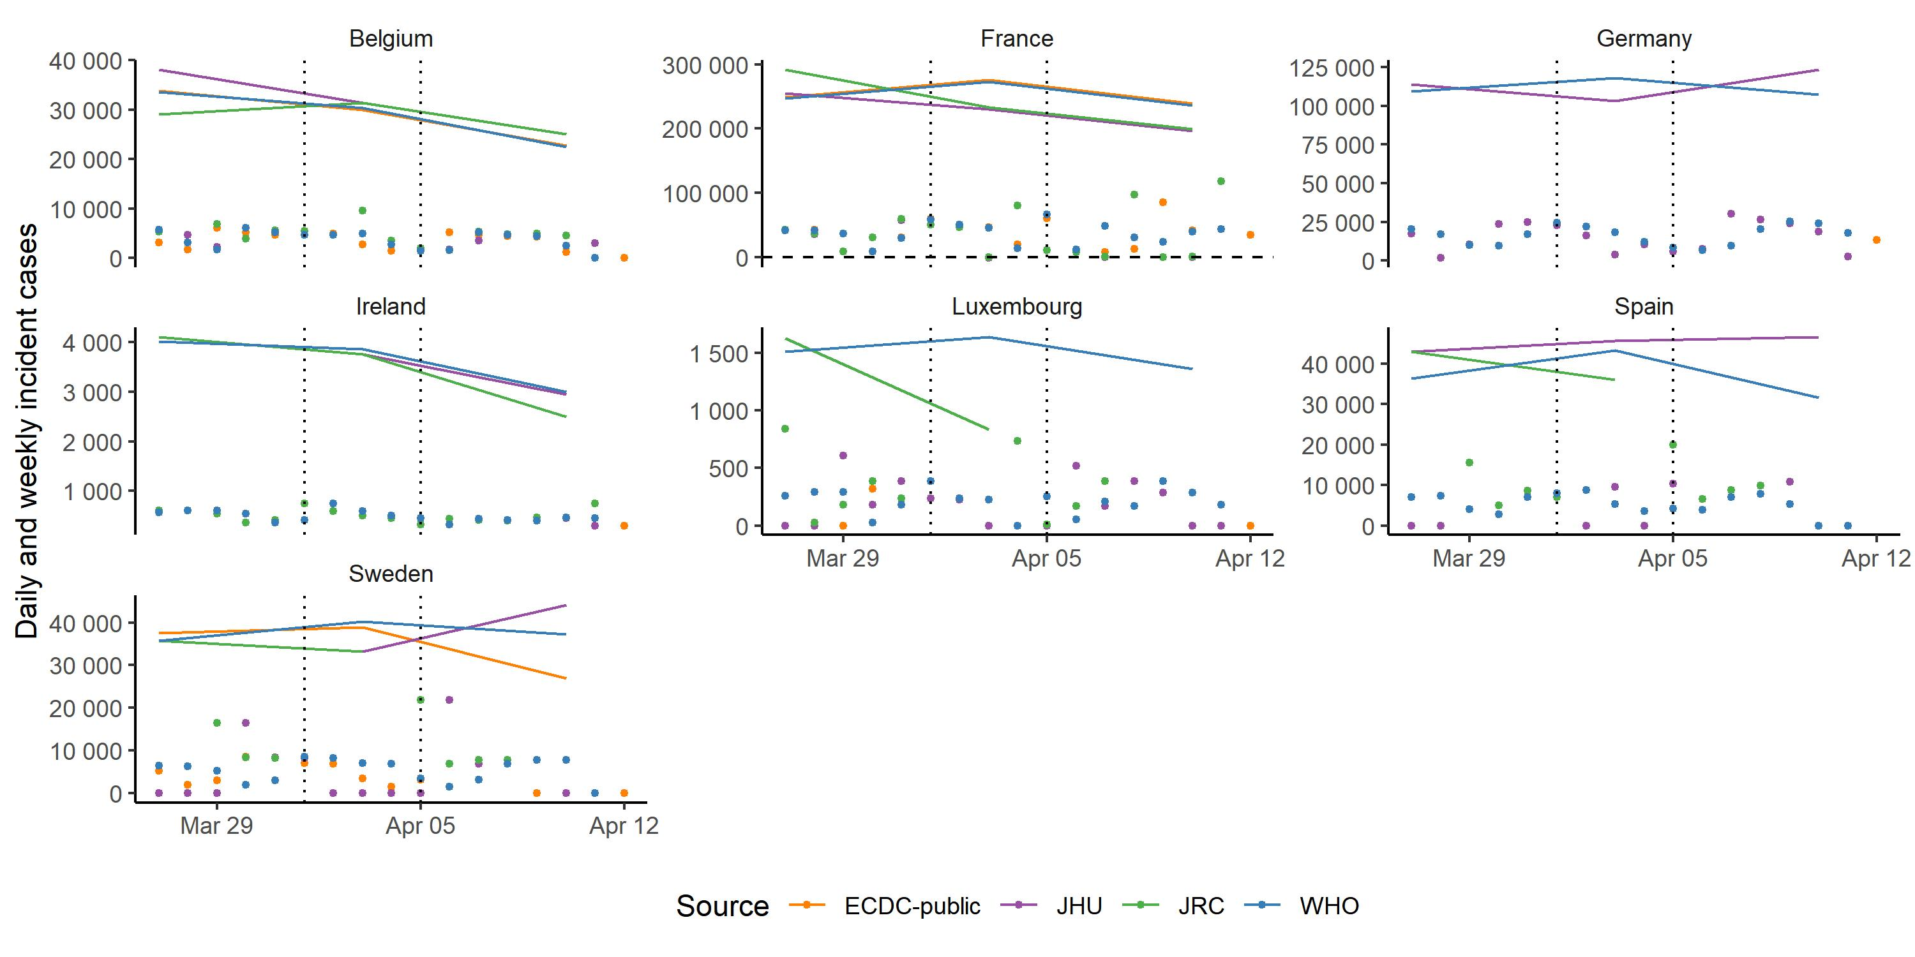
JHU differs from WHO in some countries: cases
Daily and weekly incidence cases
Countries where JHU has named an alternative public country data source
Easter period between 1st and 5th April (vertical lines)

Slide 5
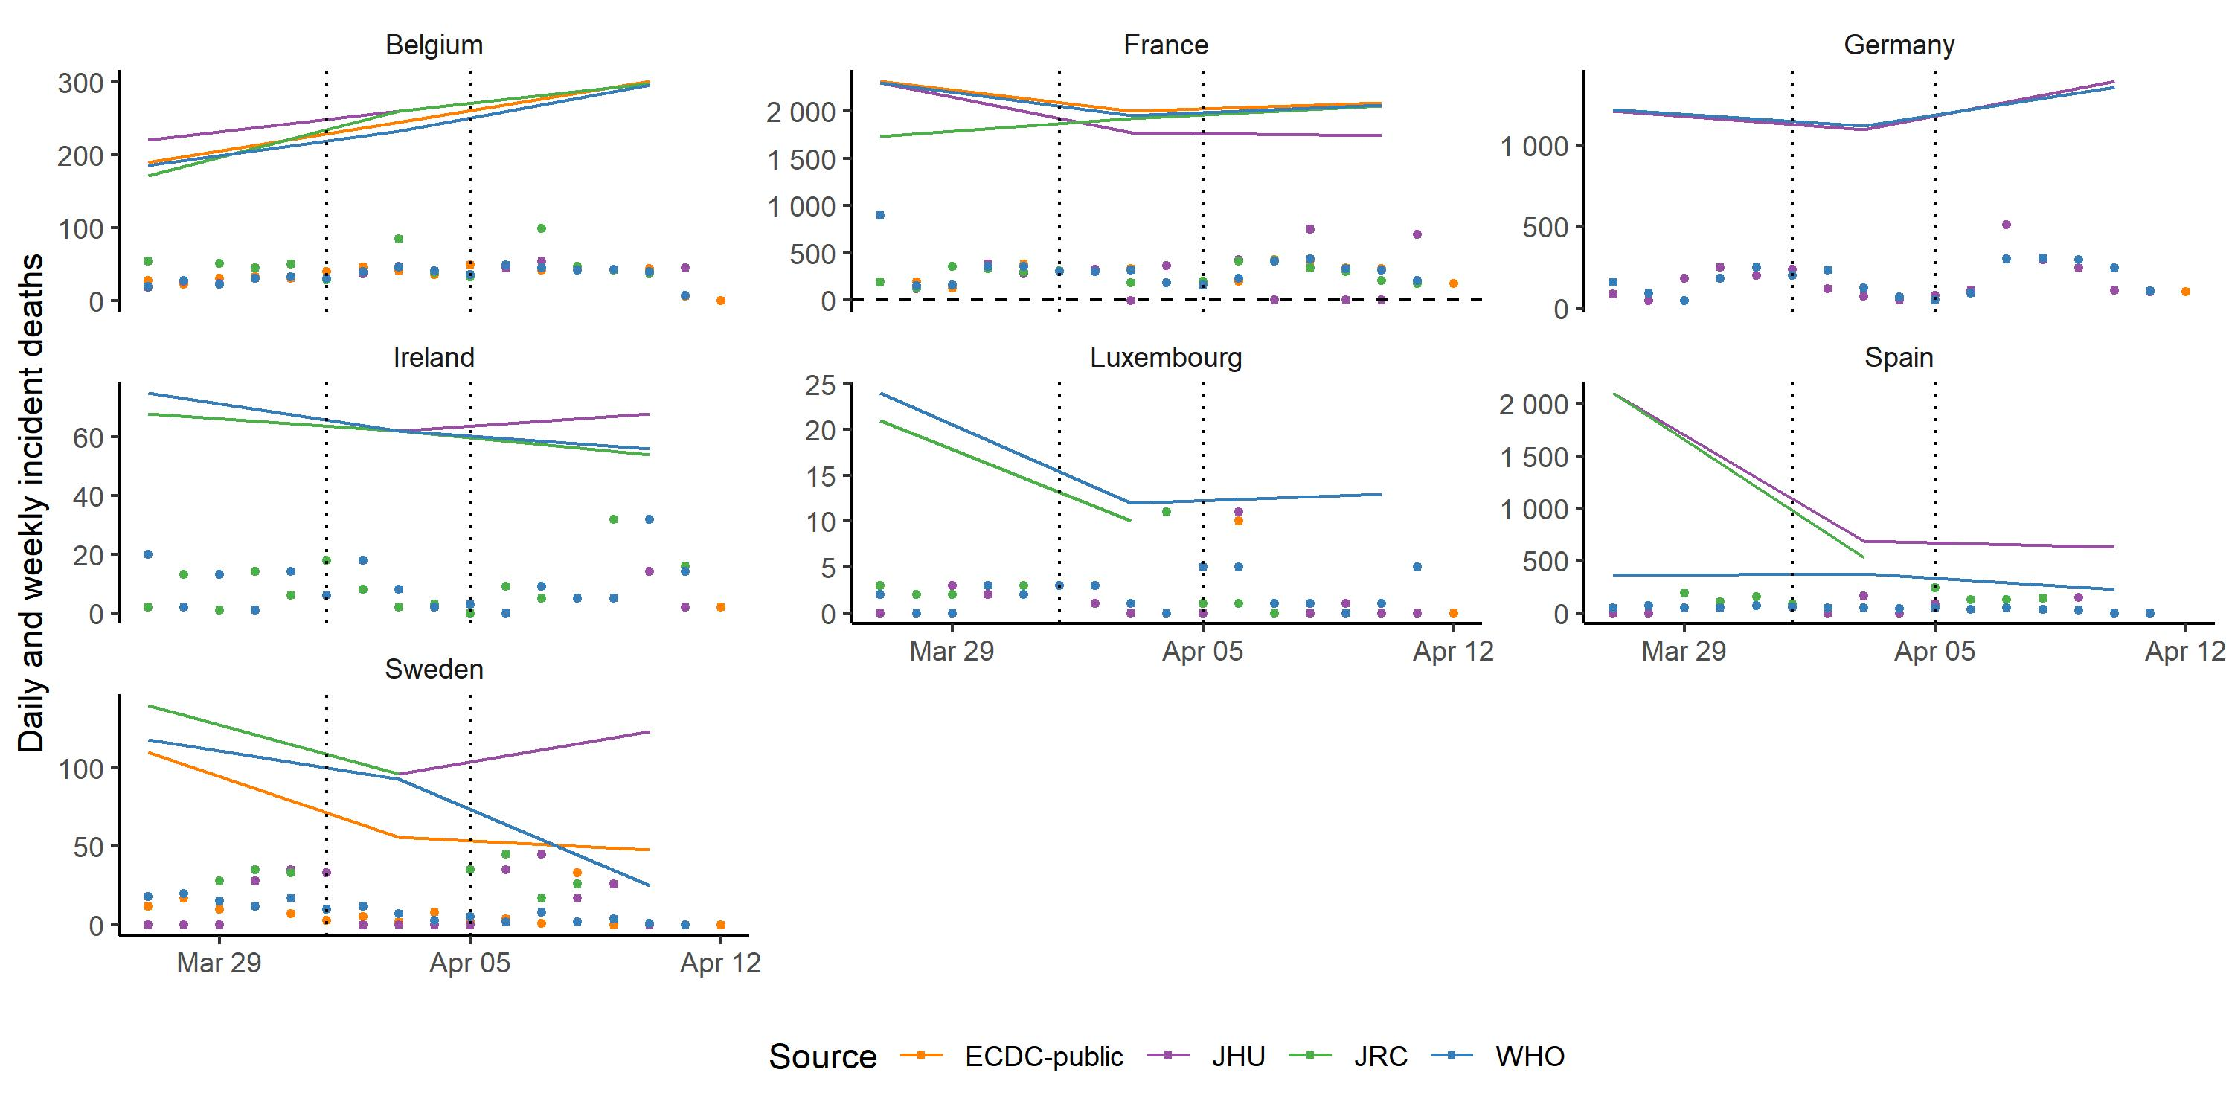
JHU differs from WHO in some countries: deaths
Daily and weekly incidence deaths
Countries where JHU has named an alternative public country data source
Easter period between 1st and 5th April (vertical lines)

Slide 6
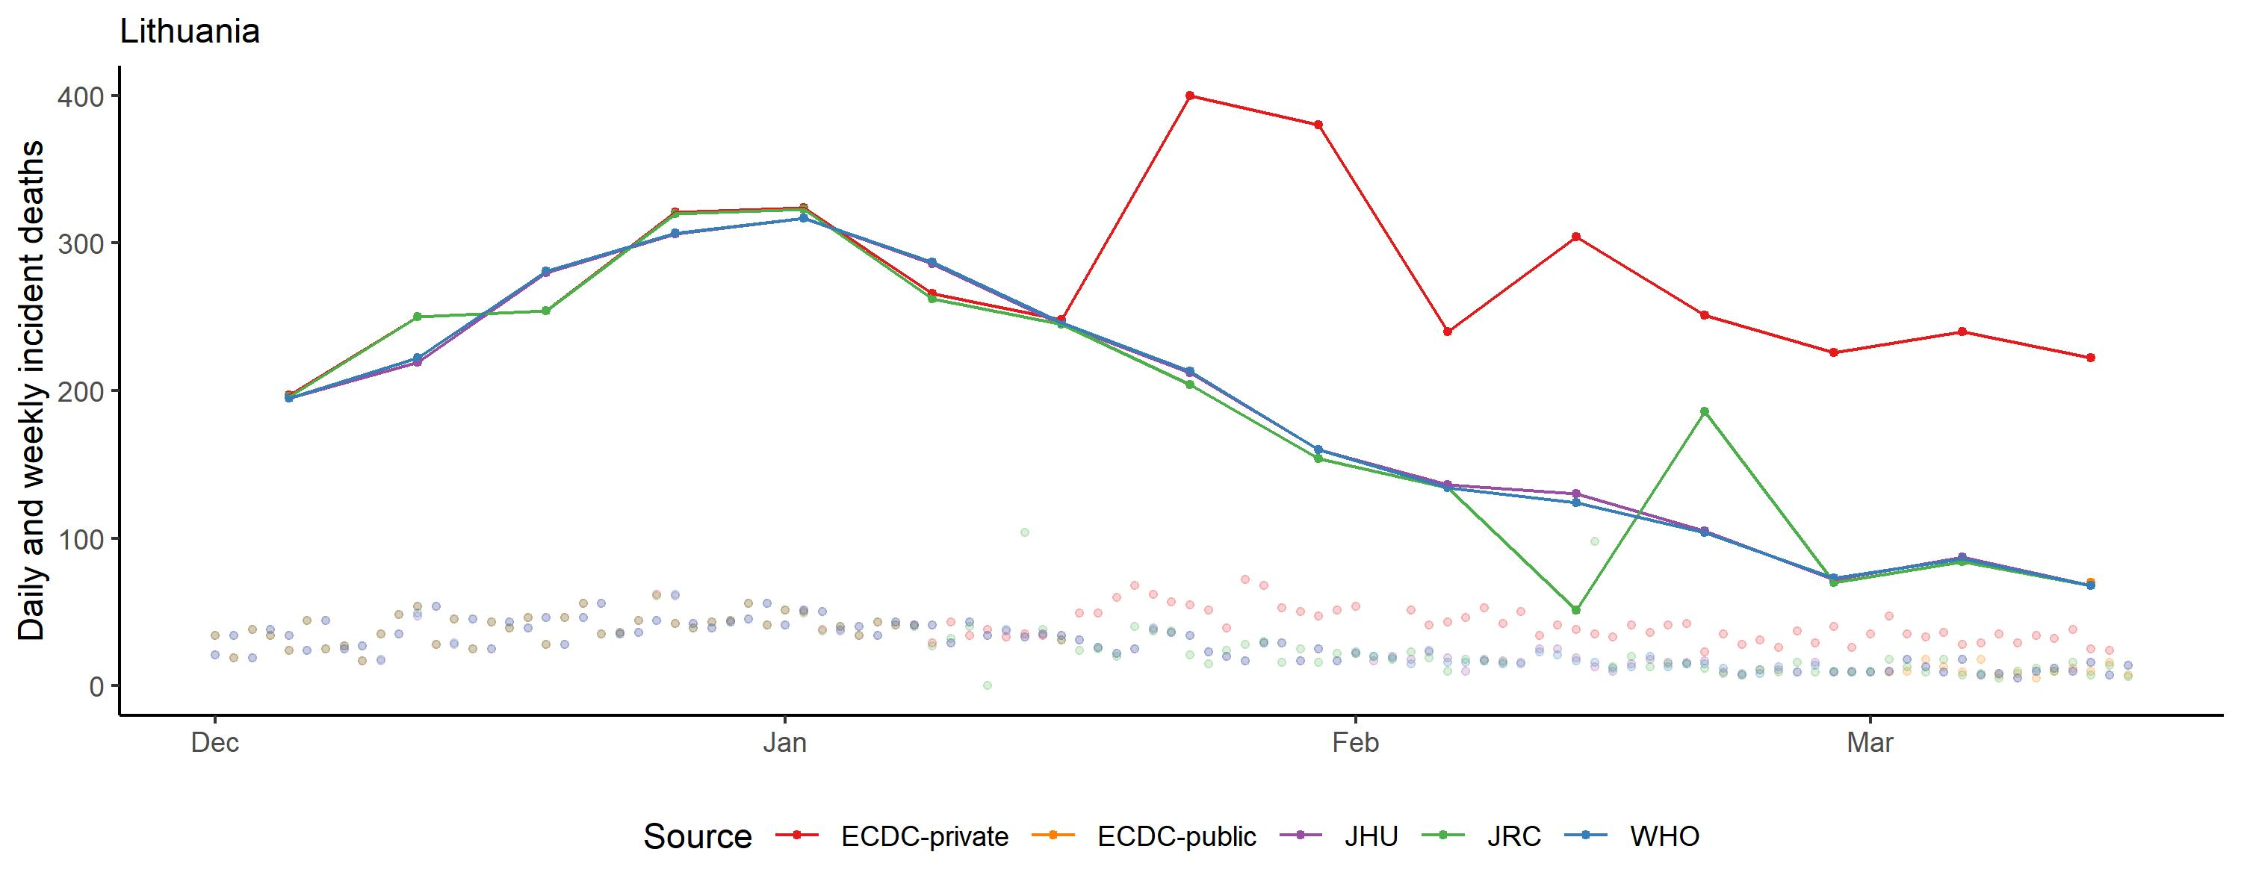
Example: Lithuania, incident deaths, Dec - Mar
1 December 2020 – 15 March 2021
See all data, 1-15-March
ECDC spikes - perhaps using old data source
Weekly data
ECDC, WHO, JHU match;
JRC leads by 1 day
JHU switches to country source
JRC has zero & NA dates;
adds to next day
Daily data
ECDC start publishing public daily data

Slide 7
Cases and deaths: summary
 | Source | Missingness | Revisions | Negative values | Overall
JRC | Public country data | Missing: 8% deaths 7% cases Added next day: large outliers | Claim to update with revisions Data suggests this doesn’t always happen | Negative values: 0.4% deaths 0.3% cases | + Timely (leads WHO by 1 day) - Large anomalies, missing + negative values
WHO | JRC ECDC Country self-report (IHR) Public country data | No missing values Missing set to zero | Updates with revisions | Negative values: 0.03% deaths 0.03% cases | + Smoother version of JRC data (more consistent revision) + Fewer negative values
JHU | WHO Public country data | No missing values Missing set to zero | Updates with revisions from source data | Negative values: 0.4% deaths 0.2% cases | - Negative values + Public
ECDC – private | TESSy Public country data JRC | Missing: 7% deaths 6% cases | ? | Negative values: 0.01% deaths 0.01% cases | + Better data quality (few negatives) - Extensive missingness
ECDC – public | ? No data for Switzerland, UK | Missing: 3% deaths 3% cases | ? | Negative values: 0.1% deaths 0.1% cases | - Some missingness - Appears lagged on WHO/JHU data

Slide 8
European data sources: healthcare
4 sources compared for Covid-19 hospitalisations and ICU
Provider | Referenced as | Data available at | Data sources from
European Commission Joint Research Centre | JRC | https://github.com/ec-jrc/COVID-19 | https://covid-statistics.jrc.ec.europa.eu/QlikDashboard?sheet=multidim
European Centre for Disease Control | ECDC – public | https://www.ecdc.europa.eu/en/publications-data/download-data-hospital-and-icu-admission-rates-and-current-occupancy-covid-19 | https://www.ecdc.europa.eu/sites/default/files/documents/2021-01-13_Variable_Dictionary_and_Disclaimer_hosp_icu_all_data.pdf
ECDC – data shared privately | ECDC – private | N/A | Unknown
Our World in Data | OWID | https://github.com/owid/covid-19-data/tree/master/public/data/ | https://ourworldindata.org/coronavirus-source-data

Slide 9
Hospitalisation & ICU: reporting process
Prevalence: current occupancy
Incidence: new admissions
Public official statistics
The European Surveillance System (TESSy)
JRC
ECDC
Prevalence
ECDC - public
ECDC - private
Incidence – weekly per 100,000
Prevalence
Incidence
Our World in Data

Slide 10
Hospitalisation & ICU: summary
JRC
Prevalence only
Covers nearly all locations but not on all dates
Only covers around half of all date/location combinations
One location missing altogether: Czechia
ECDC – private
Incidence and prevalence
Covers all locations but not on all dates
Very little ICU data
ECDC – public – daily
Prevalence only
Hospital prevalence identical to private ECDC data
Covers nearly all locations but not on all dates
Five locations missing altogether:
Greece, Malta, United Kingdom, Liechtenstein, Switzerland
ECDC – public – weekly
Incidence per 100,000
Identical to ECDC private data incidence
Covers nearly all locations but not on all dates

Slide 11
Summary
Cases and deaths:
JHU
More stable than JRC; more consistent (not missing) than ECDC
Little difference compared to WHO
Pro: JHU issues are public and maintainers are responsive
Con: WHO may have better correction for negative data
Hospitalisation and ICU:
ECDC public data
Best coverage for hospital occupancy
Coverage more consistent across the timeseries than JRC
Identical with private ECDC data

Slide 12
Country detail:
Cases & deaths

Slide 13
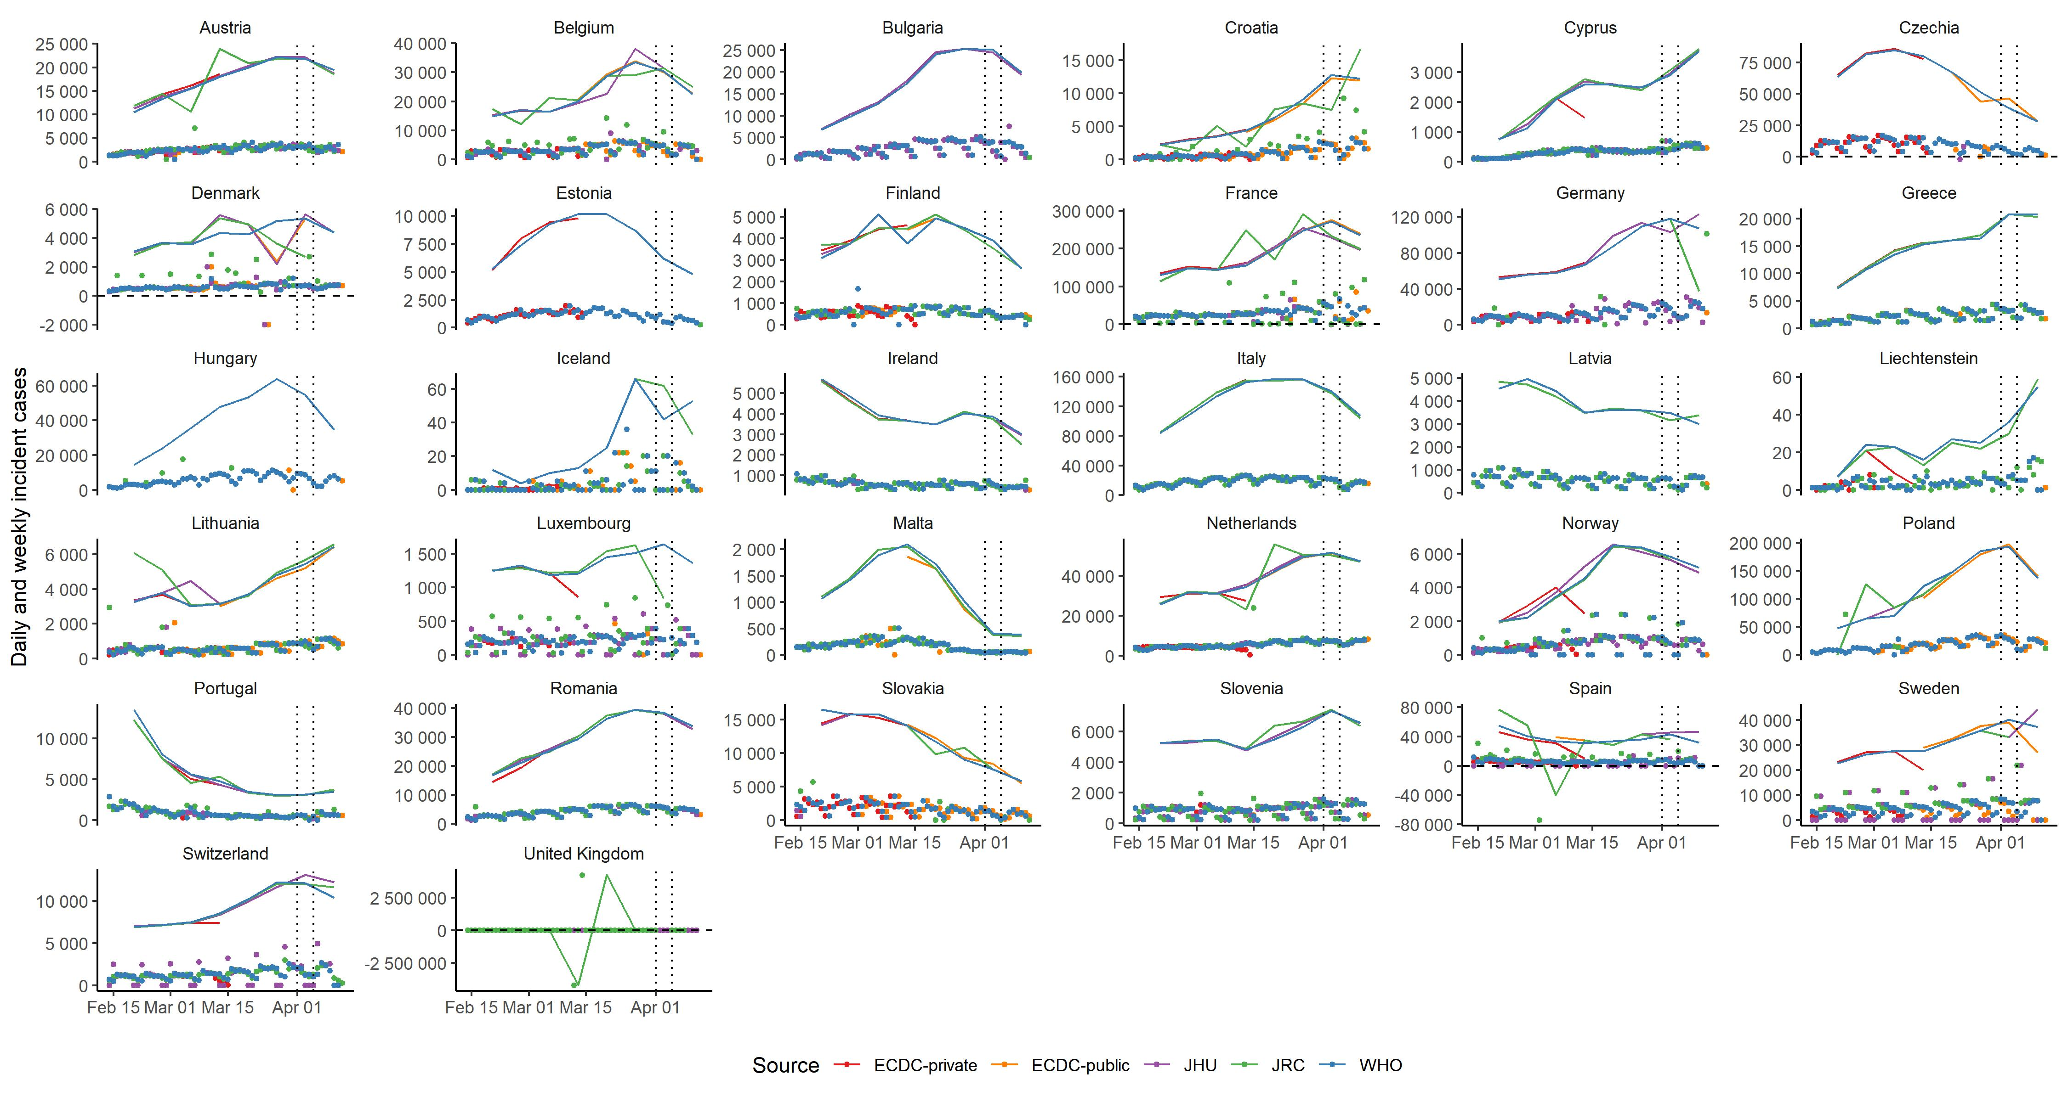
Cases by source, 15 Feb – now

Slide 14
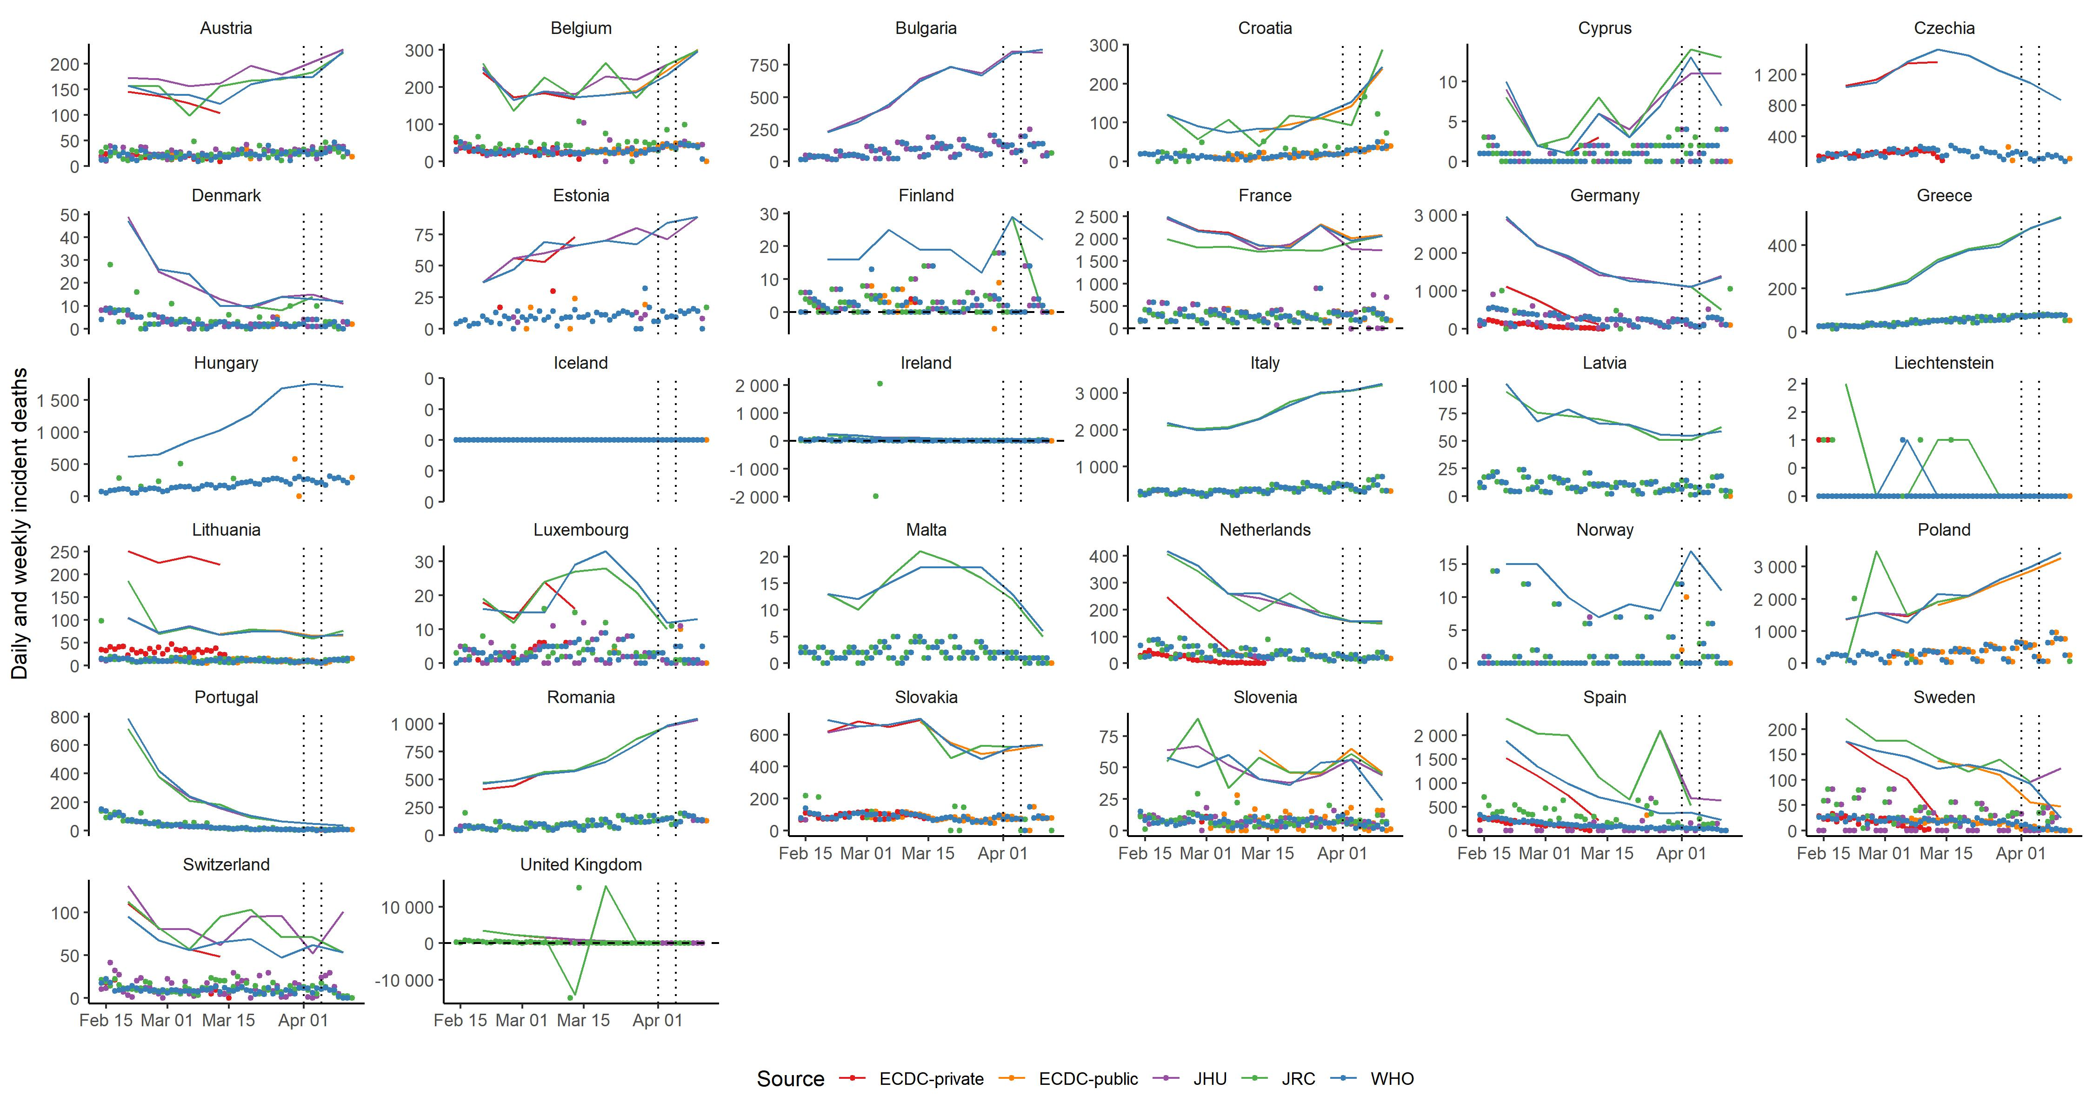
Deaths by source, 15 Feb - now

Slide 15
JHU: country public sources
Country | Source
Belgium | https://datastudio.google.com/embed/reporting/c14a5cfc-cab7-4812-848c-0369173148ab/page/giyUB
Czechia | https://onemocneni-aktualne.mzcr.cz/covid-19
France | https://dashboard.covid19.data.gouv.fr/ https://www.data.gouv.fr/en/datasets/donnees-relatives-a-lepidemie-de-covid-19-en-france-vue-densemble/ https://github.com/opencovid19-fr
Germany | https://interaktiv.morgenpost.de/corona-virus-karte-infektionen-deutschland-weltweit/
Iceland | https://www.covid.is/data
Ireland | https://covid19ireland-geohive.hub.arcgis.com/
Italy | http://www.salute.gov.it/nuovocoronavirus https://github.com/pcm-dpc/COVID-19/tree/master/dati-regioni
Kosovo | https://corona-ks.info/?lang=en and https://raw.githubusercontent.com/bgeVam/Kosovo-Coronatracker-Data/master/data.json
Lithuania | https://osp.maps.arcgis.com/apps/MapSeries/index.html?appid=c6bc9659a00449239eb3bde062d23caa
Luxembourg | https://data.public.lu/fr/datasets/covid-19-rapports-journaliers/#_
Netherlands | https://experience.arcgis.com/experience/ea064047519040469acb8da05c0f100d
Serbia | https://covid19.rs/homepage-english/
Slovakia | https://korona.gov.sk/
Spain | https://www.rtve.es/noticias/20200514/mapa-del-coronavirus-espana/2004681.shtml
Sweden | https://experience.arcgis.com/experience/09f821667ce64bf7be6f9f87457ed9aa
Turkey | https://covid19.saglik.gov.tr/EN-69532/general-coronavirus-table.html
UK | https://coronavirus.data.gov.uk/#category=nations&map=rate

Slide 16
Country detail:
Hospitalisation & ICU

Slide 17
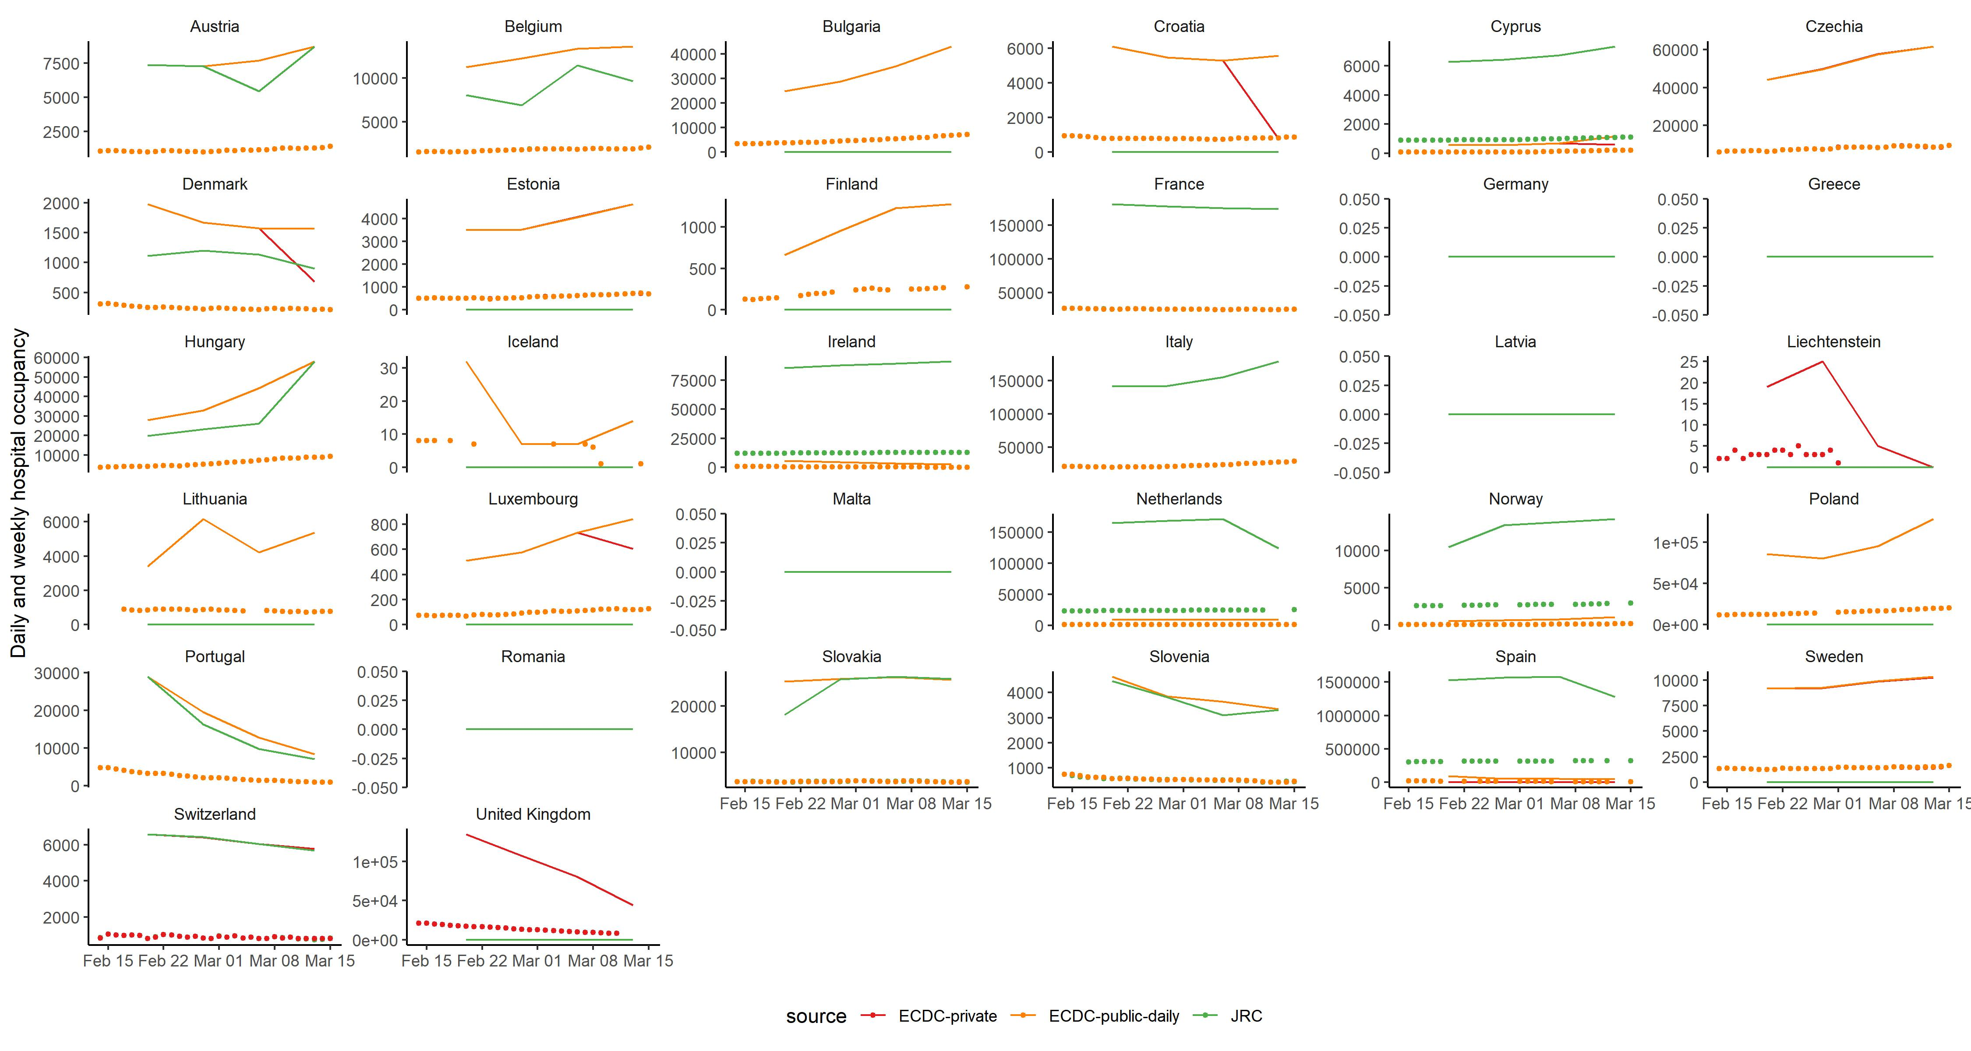
Hospital occupancy by source, 15 February – 15 March

Slide 18
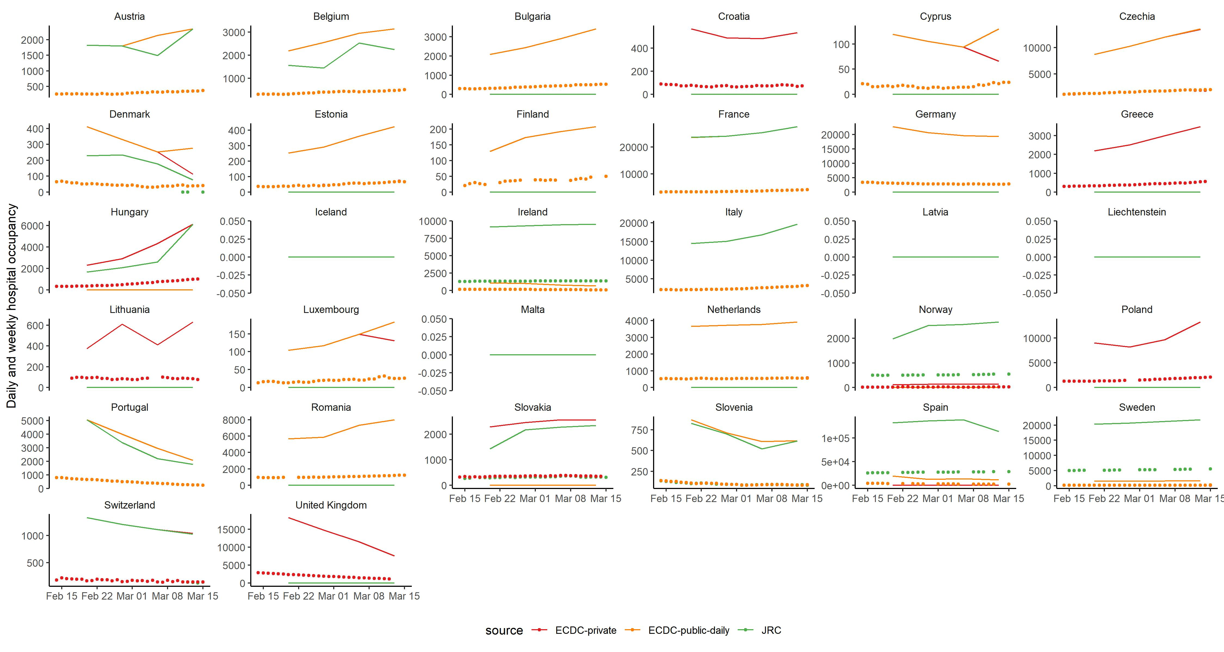
ICU occupancy by source, 15 February – 15 March

Slide 19
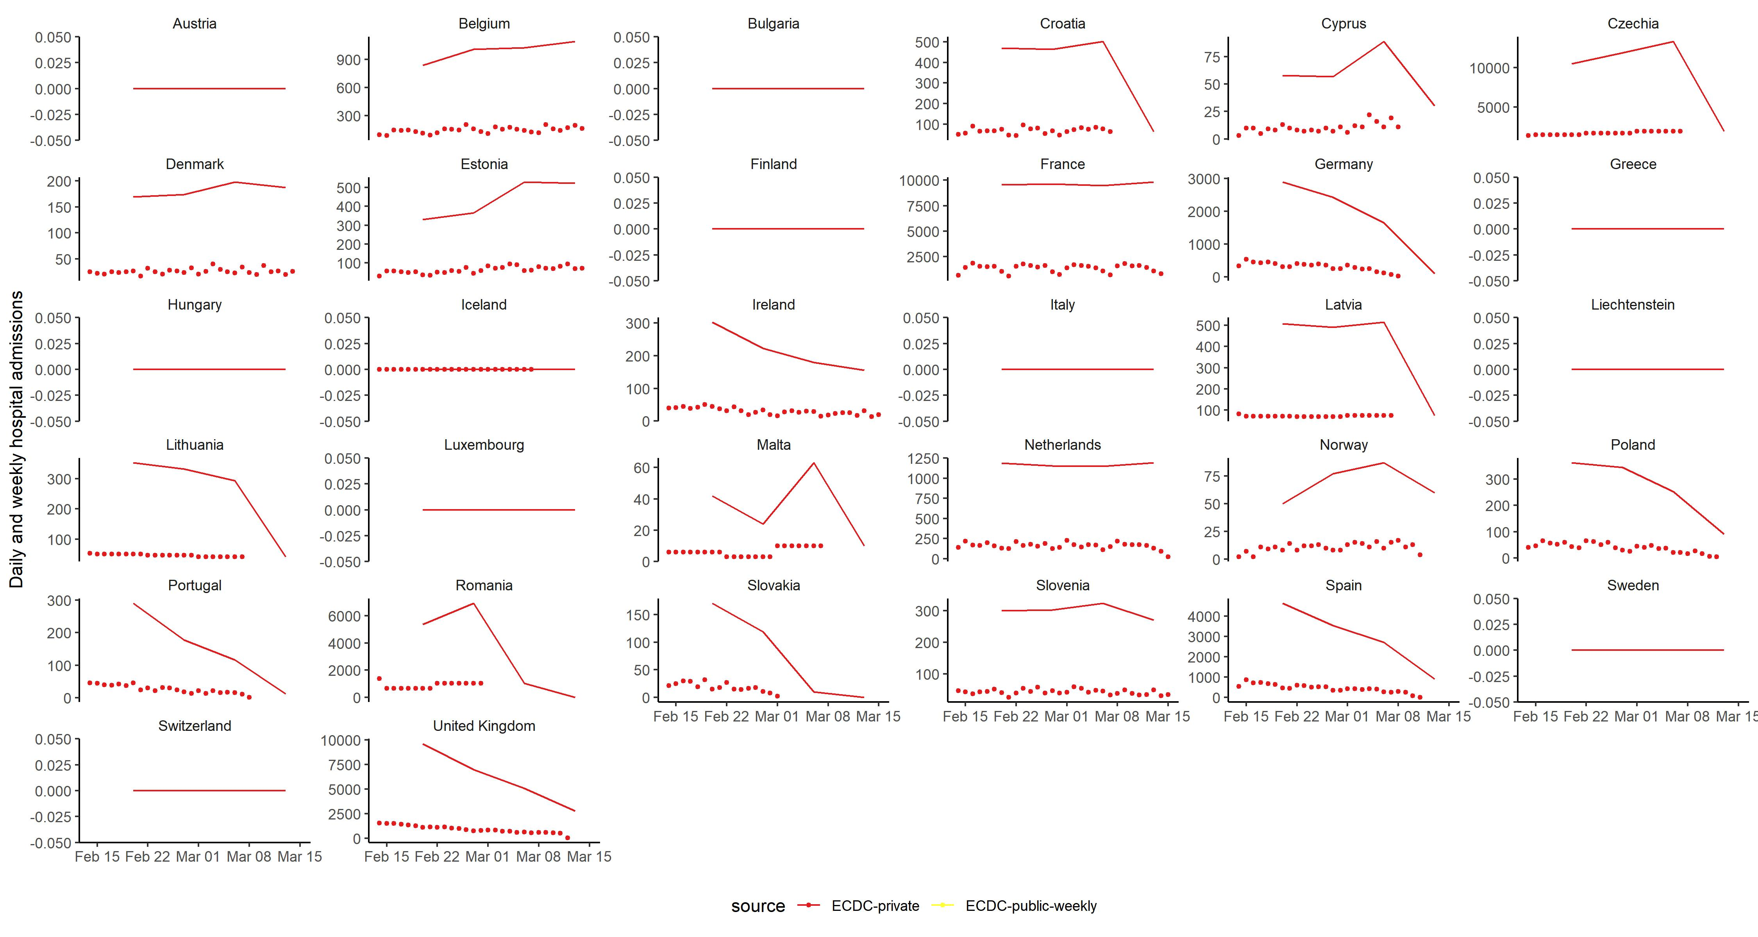
Hospital admissions by source, 15 February – 15 March

Slide 20
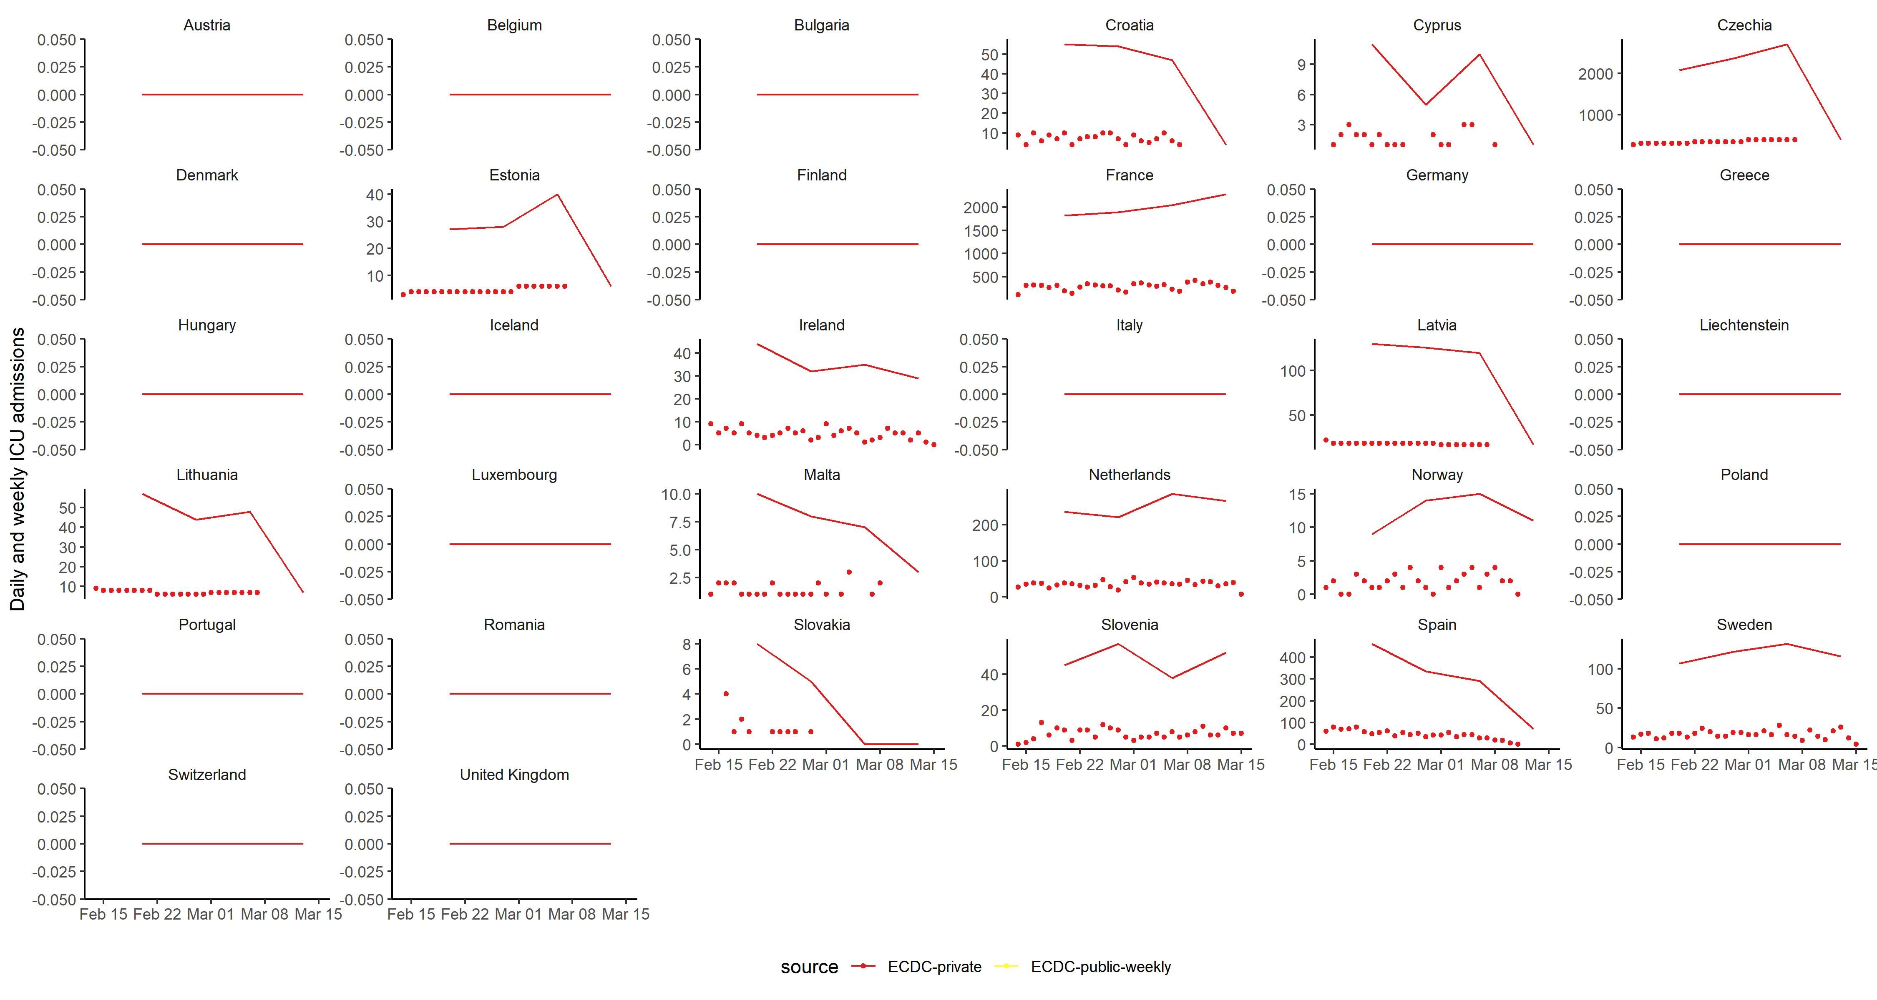
ICU admissions by source, 15 February – 15 March

